Slide 1
Deep Learning
Or why you should just ask a computer to figure it out.

Slide 2
Deep Learning
The worst explanation ever
A long chain of linear and non-linear tensor (read: matrix) transformations to transform input to output.
Note: Read chapter 1 of d2l.ai for more context.

Slide 3
A Graphical Explanation
raw bit
sequence
Long transformation
chain
High
dimensional
vectors
Downstream
tasks
Preprocessing
(Encoding)
(Decoding)
Notes:
Encoding and decoding are very broad terms.
At a high level though, you will see that encoding is transferable, and decoding is task specific.

Slide 4
When should Deep Learning be used?
When the behavior of the system cannot be reduced to a finite(and manageable) set of rules.
Notes:
A full scale chess program would need 10^123 possible moves, or the Shannon number, which is more than the number of atoms in the observable universe.

Slide 5
What are the ingredients?
Objective function
Data
Model
Algorithm
Notes:
Data is well, data. If you can’t program the rules, then you need the input and output.
The model consists of the encoder and decoder sections and converts input to output.

Slide 6
Applications
A very incomplete list.
Natural language Processing (NLP)
Computer Vision (CV)
(RNNs and Transformers)
(CNNs, GANs, UNets, etc)
Text classification
Text generation
Summarization/ Extraction
Image/video classification
Segmentation
Object detection
Style Transfer
Generation
Super resolution
Taking RNNs further:
Time series analysis
Audio Analysis
Taking CV further:
Audio Analysis (Frequency spectrum analysis)

Slide 7
Dataset Sources
AWS datasets (link)
Google dataset search (link)
Kaggle (link)
DrivenData (link)
Note: You MUST find a dataset set and problem you’re interested in, or you’ll get bored.

Slide 8
PyTorch vs. TensorFlow
Somewhat subjective at certain points
PyTorch
TensorFlow
More pythonic (good class definitions)
Easier to write (subjective?)
Not so much diversity in platform support
Serving libraries are newer
Less pythonic (functions separated from objects)
Harder to write (?)
More diverse platform support (.js, embedded)
More mature serving libraries
Note: I will be using PyTorch, but it is important to learn both, since it will allow you to read more repos.

Slide 9
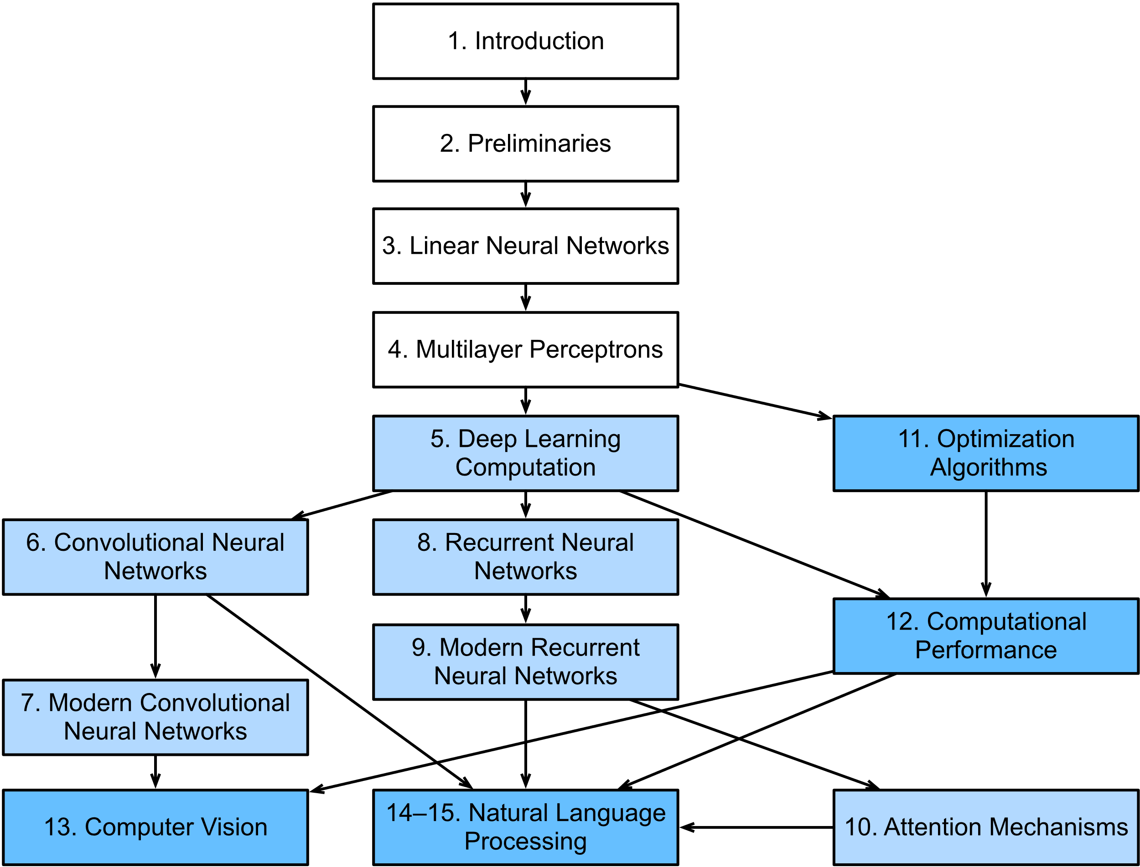
Pathway
Week 1 – Chapter 2, 3,
Week 2 – Chapter 4, 5
Week 3 – Chapter 6, 7
Week 4 – Chapter 8, 9
Week 5 – Chapter 10, 11,
Week 6 – Chapter 12
Week 7 – Chapter 13
Week 8 – Chapter 14, 15
Week 9 – Chapter 16,
Week 10 – Chapter 17
Note: Image source – d2l.ai
We will use and build on this reference for almost the entire study of Deep Learning: https://d2l.ai/

Slide 10
The Basics
What do you need to know?
Some Python (probably easier that way)
References
Look here first:
https://docs.google.com/document/d/1Cw6fA5Ne7gGnLA2NM_Fy1KJuOZEBW5JToXSvFfxl_Lw/edit?usp=sharing
Ask me/host for the slides if you want them.
It will probably end up on some git repo along with the code.
Repo:
https://github.com/kradkahaddi/snakesandmachines

Slide 11
The Basics
Method
I will (usually) introduce certain topics via recorded videos and host further explanation on weekends. (recorded)
A volunteer can revise the topics and dig deeper during the following week (recorded)
It will be good for discussions if everyone has read the material and perspectives to share and questions to ask
Opensource license for all additional code and materials: MIT or similar
(free usage, distribution, and modification)

Slide 12
The Basics
What do you need to Volunteer?
A better than zero understanding of the topic. My example (could be better for sure): https://www.youtube.com/watch?v=w46AX1jQhjM
Some Prep
The main jupyter notebook with properly flowing code sections.
A requirements.txt for your code environment.
(Optional) A second code notebook if you want to do scratch work
(Optional) A set of .py files to support as imports.
(Optional) A slide deck if you want to give an overview of the topic before heading to the code.
A Sanity Check
Don’t over think what you’re going to do.
Ask someone to review your work before you present.
Nobody succeeds alone, be open to receiving help.
This command should work for most environments:
pip freeze > requirements.txt
Note: You MUST have the main jupyter notebook and requirements.txt to present.

